Slide 1
Picking
WMS Guide

Slide 2
Table of Contents
Outbound Order Wave……………….…......................................................................................................3
  Wave Building, Planning and Release.............................................................................................3
  Additional Options: Cancelation, Suspension, Replanning…........................................................21
Picking with a Mobile Device................................................................................................................41
  Pick by Order..................................................................................................................................41
  Pick by Shipment...........................................................................................................................52
  Cluster Picking...............................................................................................................................57
  Container Pick Complete...............................................................................................................66
  Exceptions……………………................................................................................................................70
Conventional Picking…………………………….…..........................................................................................77

Slide 3
Outbound Order Wave
Wave Planning and Release

Slide 4
Wave Building, Planning and Release
This process allows you to select outbound orders to be grouped together allowing the release of picking in the warehouse.
Building, Planning and Releasing a wave of outbound orders make orders available for picking.
Three steps are required :
  Building the wave of outbound orders,
  Planning the wave,
  And releasing the wave,

Slide 5
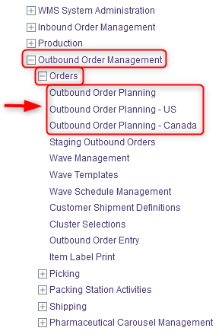
Wave Building, Planning and Release
To build a wave of outbound orders, do this:
With a desktop computer, select the Outbound Order Management resource.
Under Outbound Order Management, click on Orders.
Under Orders, click on Outbound Order Planning – US or Outbound Order Planning – Canada .

Slide 6
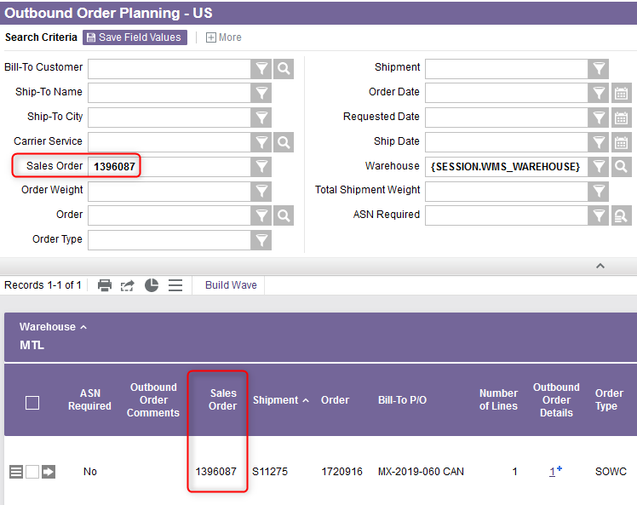
Wave Building, Planning and Release
Specify search criteria for the order(s) you wish to plan. Upon doing so, the results of the search are displayed:

Slide 7
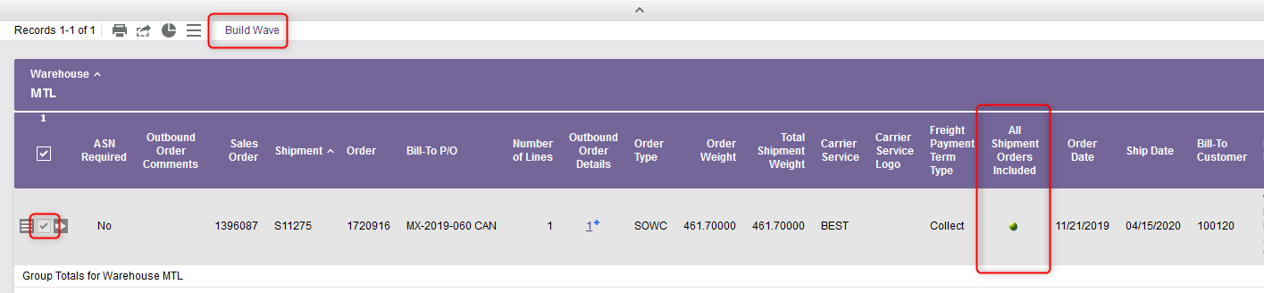
Wave Building, Planning and Release
Select one or more orders to include in the wave. A wave must contain at least one order.
Make sure the flag is green in the All Shipment Orders Included column. This column indicates whether or not additional orders exist that are associated with the shipment number shown in the search results, but that are on hold. When the flag is red, then such orders exist. Otherwise, the flag is green.
Then select the Build Wave action.
Notes:
Ici s’assurer que All Shipment Order Include

Slide 8
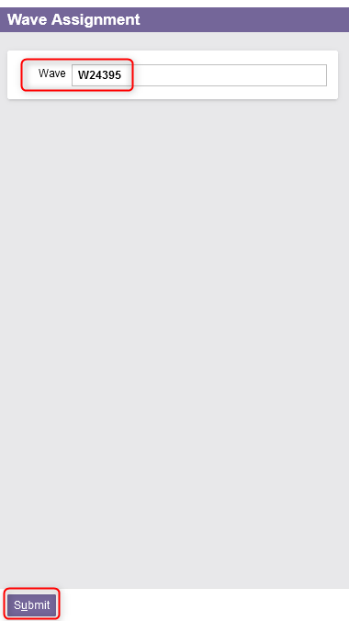
Wave Building, Planning and Release
A new Wave Assignment window appears. The next available wave number is displayed. Take note of the wave number for future reference.
Select the Submit action to confirm.

Slide 9
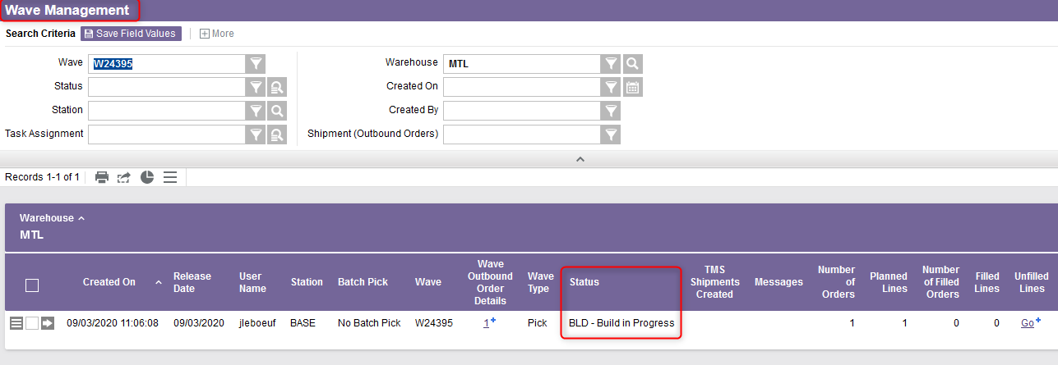
Wave Building, Planning and Release
The system will create a wave with the “BLD - Build in Progress” status, and then will advance automatically to the Wave Management resource.
You are now ready to plan the wave.

Slide 10
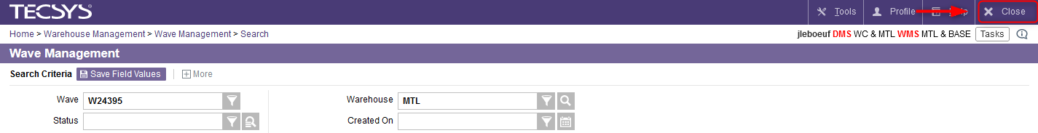
Wave Building, Planning and Release
At this stage, two options are available:
  Option 1 : Plan the wave you just built by continuing directly with the Wave Management resource. Refer to the step #17 (slide 13) for the rest of this process.
  Option 2 : Exit the Wave Management resource by clicking on Close in the top right corner and plan the wave later.

Slide 11
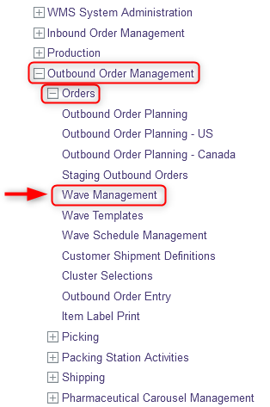
Wave Building, Planning and Release
To plan a wave of outbound orders by choosing the second option, do this:
With a desktop computer, select the Outbound Order Management resource.
Under Outbound Order Management, click on Orders.
Under Orders, click on Wave Management.

Slide 12
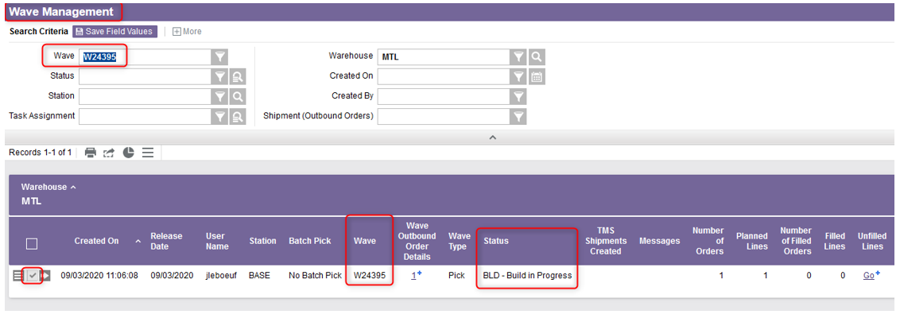
Wave Building, Planning and Release
Perform a search that will retrieve the wave you wish to plan.
Select the wave. The wave must be assigned a status of “BLD - Build in Progress”.

Slide 13
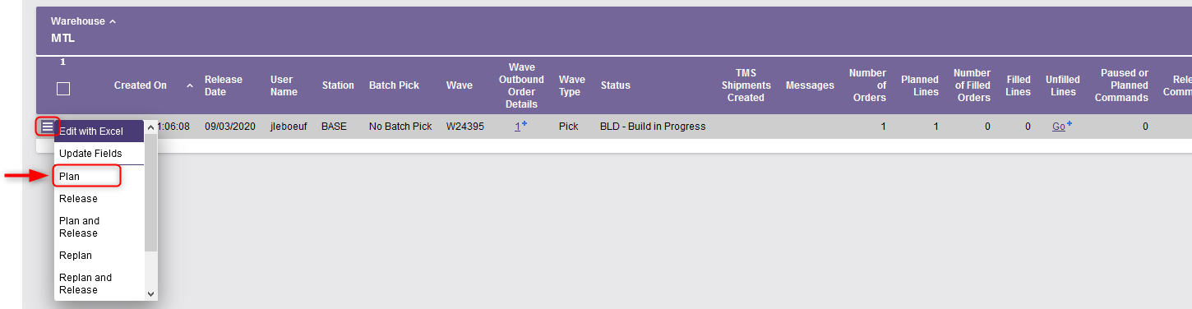
Wave Building, Planning and Release
Select the Use Record as Criteria for Action button and click on the Plan action.
Note: If you chose to plan the wave directly after its creation (option 1), follow the instructions from this step.

Slide 14
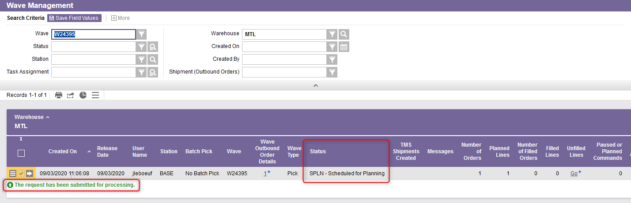
Wave Building, Planning and Release
A confirmation message will appear. Once the Plan action has been selected, the wave's status is temporarily changed to “SPLN - Scheduled for Planning”.
You are now ready to release the wave.

Slide 15
Wave Building, Planning and Release
Again, at this stage, two options are available:
  Option 1 : Release the wave you just planned by continuing directly with the Wave Management resource. Refer to the step #26 (slide 19) for the rest of this process.
  Option 2 : Exit the Wave Management resource by clicking on Close in the top right corner and release the wave later.

Slide 16
Wave Building, Planning and Release
To release a wave of outbound orders by choosing the second option, do this:
With a desktop computer, select the Outbound Order Management resource.
Under Outbound Order Management, click on Orders.
Under Orders, click on Wave Management.

Slide 17
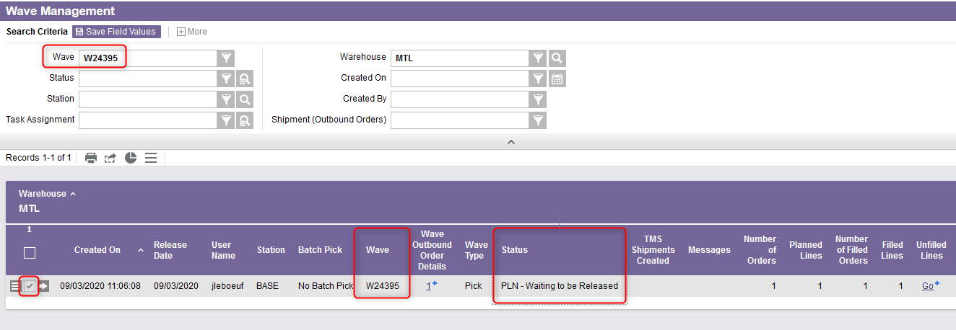
Wave Building, Planning and Release
Perform a search that will retrieve the wave you wish to release.
Select the wave. The wave must be assigned a status of “PLN - Waiting to be Released”.

Slide 18

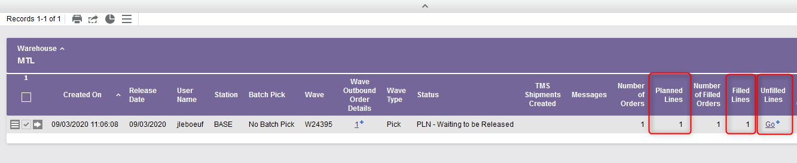
Wave Building, Planning and Release
At this step, make sure that the value in the Filled Lines column equals the value in the Planned Lines column. Click on in the Unfilled Lines column to view the specific unfilled lines.
  Note: The Filled Lines column indicates the total number of lines for all orders associated with this wave. The Planned Lines column indicates the total number of lines planned for all of the orders associated with a given wave.

Slide 19
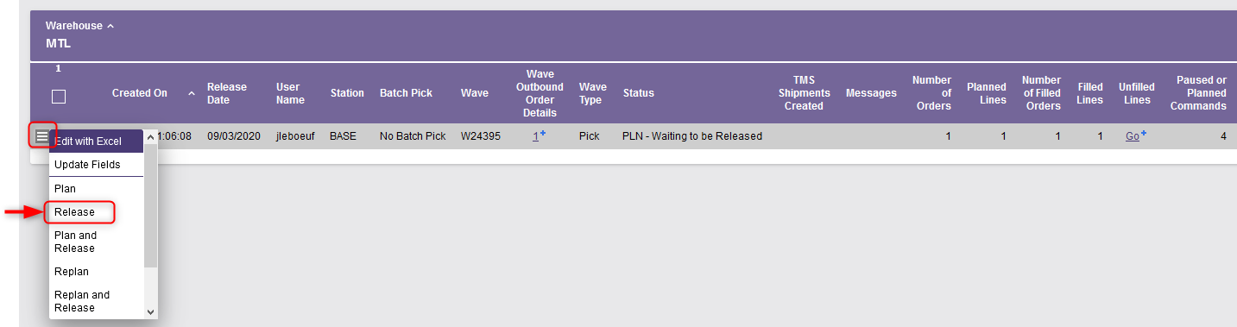
Wave Building, Planning and Release
Then select the Use Record as Criteria for Action button and click on the Release action.
Note: If you chose to release the wave directly after its planning (option 1), follow the instructions from this step.

Slide 20
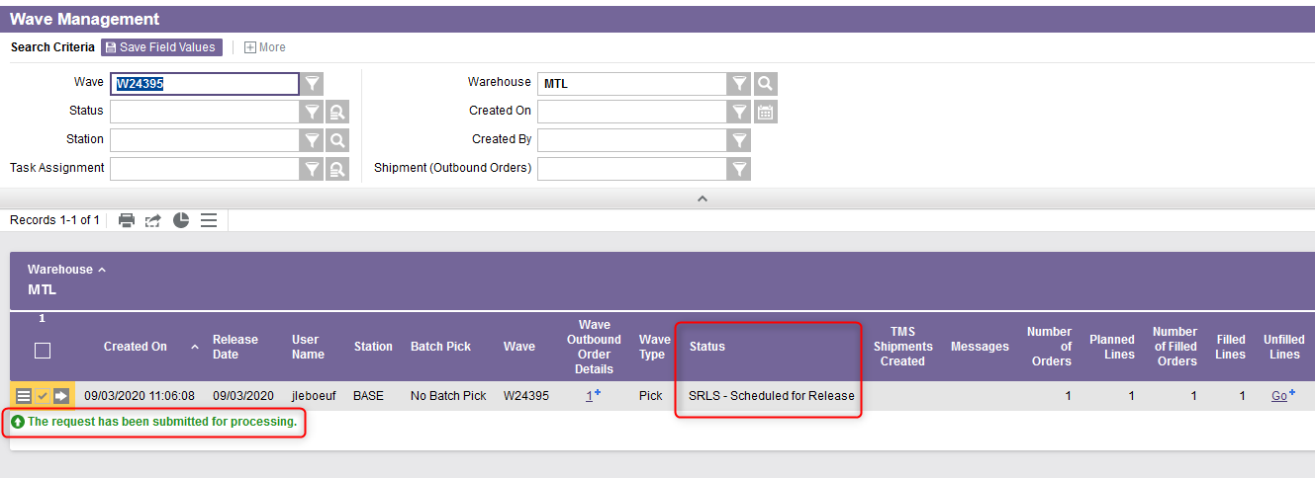
Wave Building, Planning and Release
A confirmation message will appear. Once the Release action has been selected, the wave's status is temporarily changed to “SRLS - Scheduled for Release”.
This step ends the process of releasing a wave. You are now ready to start picking.

Slide 21
Outbound Order Wave
Additional Options

Slide 22
Wave Cancelation
The Wave Management resource enables you to cancel a selected wave and place its orders on hold. Canceling a wave is the equivalent of deleting the wave from the system.
Only waves with the following statuses can be canceled:
  SUSP – Suspended
  BLD – Build in Progress
  PLN – Waiting to Be Released

Slide 23
Wave Cancelation
To cancel a wave of outbound orders, select the Wave Management resource.

Slide 24
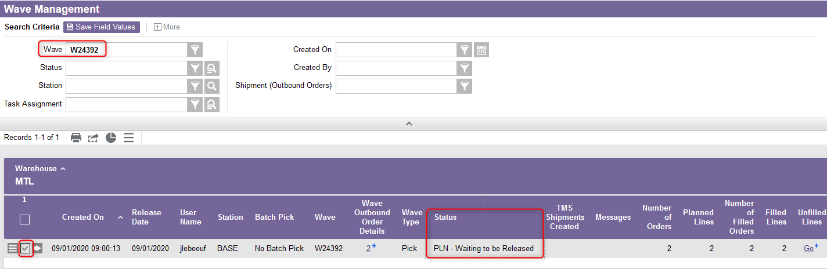
Wave Cancelation
Perform a search that will retrieve the wave you wish to cancel.
Select the wave. The wave must be assigned a status of SUSP, BLD or PLN.

Slide 25
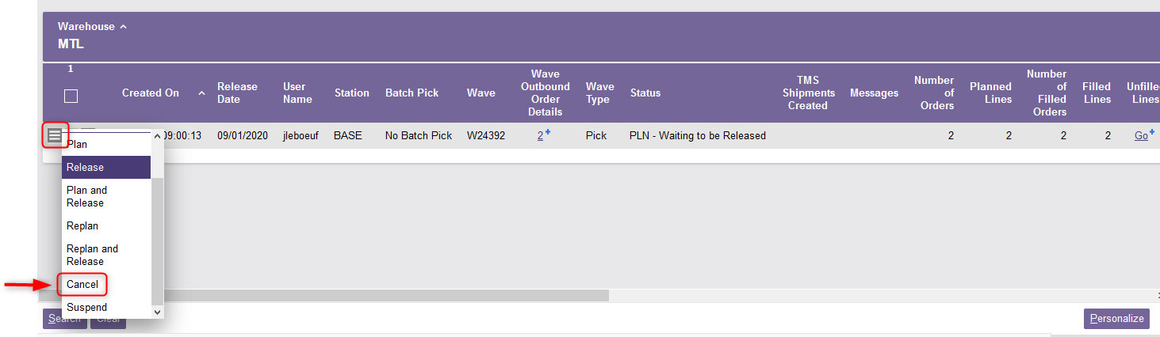
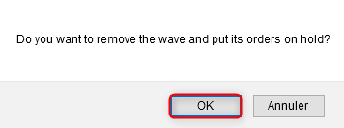
Wave Cancelation
Select the Use Record as Criteria for Action button and click on the Cancel action.
You are prompted to confirm that you want to delete the wave and place its orders on hold. Click OK to confirm.

Slide 26
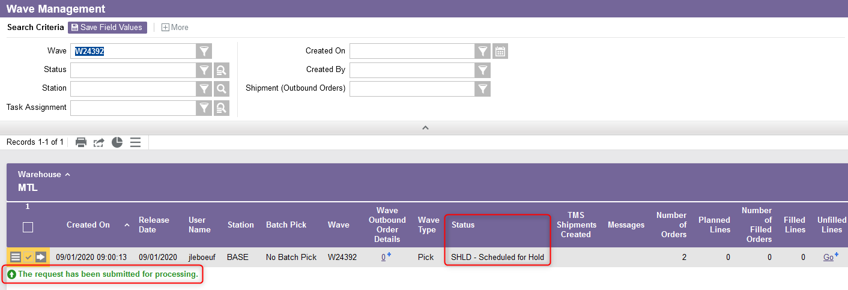
Wave Cancelation
A confirmation message will appear. Once the Cancel action has been selected, the wave's status is changed to “SHLD - Scheduled for Hold.”

Slide 27
Wave Suspension
The Wave Management resource enables you to suspend the processing of a given wave.
Suspending a wave retains all commands and wave planning, but temporarily prevents commands from being processed.
    In other words, inventory remains allocated to line items in the outbound order, but the pick commands are paused.
Only waves that have the status “RDY - Ready to Pick” can be suspended.
The suspended wave must be released again before being processed.

Slide 28
Wave Suspension
To suspend a wave of outbound orders, select the Wave Management resource.

Slide 29
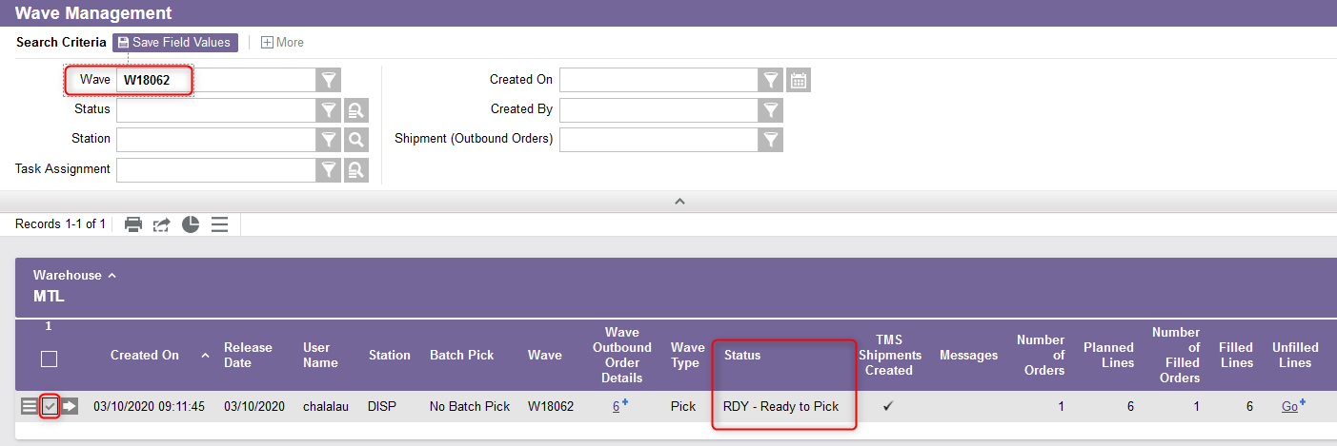
Wave Suspension
Perform a search that will retrieve the wave you wish to suspend.
Select the wave. The wave must be assigned a status of RDY.

Slide 30
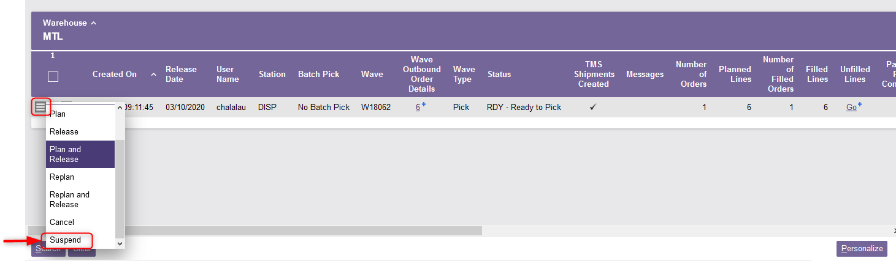
Wave Suspension
Select the Use Record as Criteria for Action button and click on the Suspend action.

Slide 31
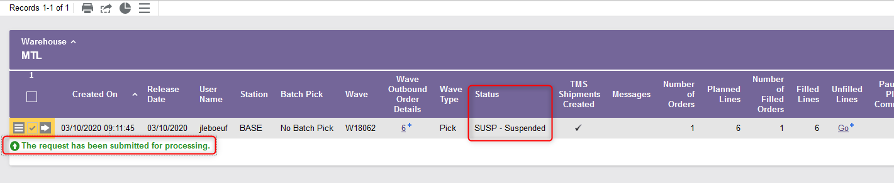
Wave Suspension
A confirmation message will appear. Once the Suspend action has been selected, the wave's status is temporarily changed to “SUSP – Suspended”.

Slide 32
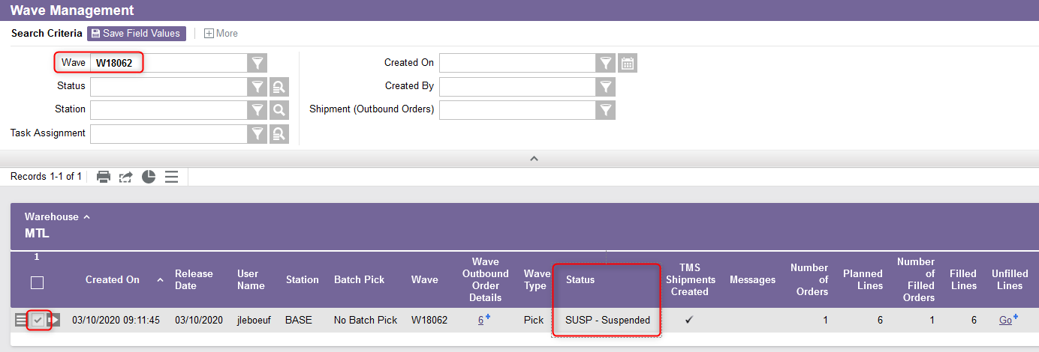
Wave Suspension
If you want to remove a wave from suspension status, from the Wave Management resource, perform a search that will retrieve the wave you wish to process. Select the wave. The wave must have the status "SUSP - Suspended".

Slide 33
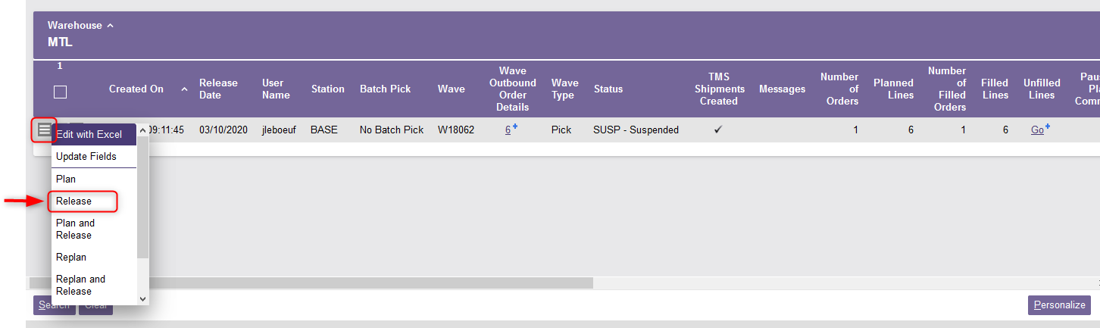
Wave Suspension
Select the Use Record as Criteria for Action button and click on the Release action.

Slide 34
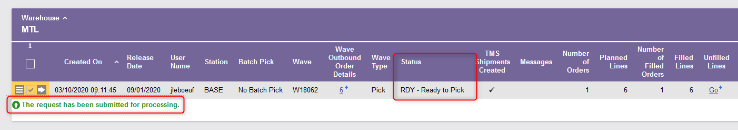
Wave Suspension
A confirmation message will appear. The wave's status is changed again to “RDY – Ready to Pick”.

Slide 35
Wave Replanning
This action involves restarting the planning process for a given wave.
Replanning is necessary when the values of the fields used for planning or which have an impact on shipment have been changed.
  For example, if the shipping date of a given order has been postponed, it may be necessary to replan the wave that includes this order.

Slide 36
Wave Replanning
To replan a wave of outbound orders, select the Wave Management resource.

Slide 37
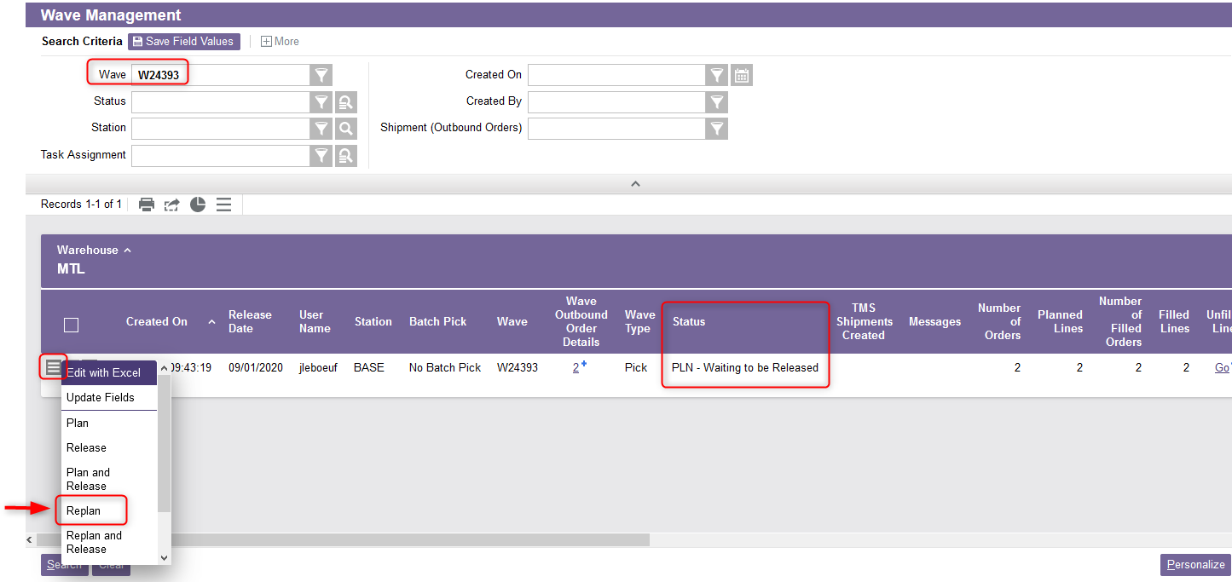
Wave Replanning
Perform a search that will retrieve the wave you wish to replan.
Select the Use Record as Criteria for Action button and click on the Replan action.

Slide 38
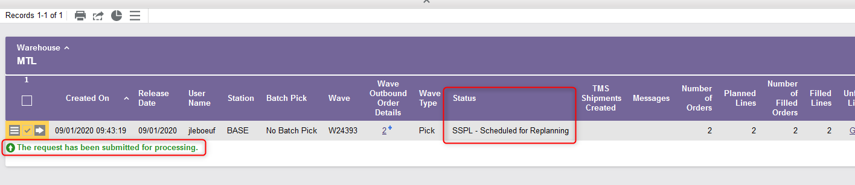
Wave Replanning
A confirmation message will appear. The wave's status is changed again to “SSPL - Scheduled for Replanning”.

Slide 39
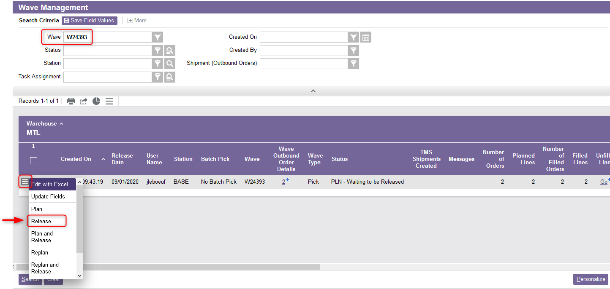
Wave Replanning
You are now ready to release the wave again. To do this, from the Wave Management resource, select the Use Record as Criteria for Action button and click on the Release action.

Slide 40
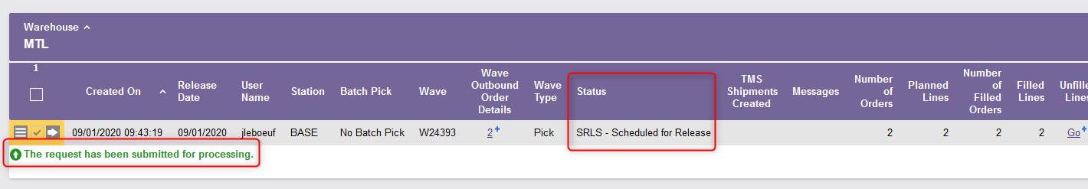
Wave Replanning
A confirmation message will appear. The wave's status is changed again to “SRLS - Scheduled for Release”.

Slide 41
Picking with a Mobile Device
Pick by Order

Slide 42
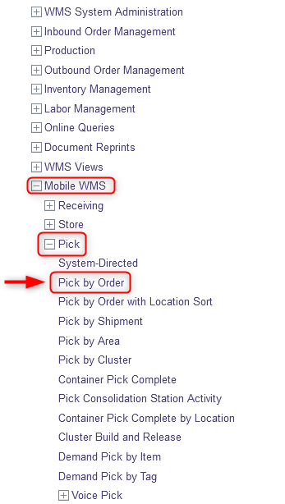
Pick by Order
The Pick by Order resource allows the user to specify the products to be picked for an outbound order. To do this:
With a mobile device, select the Pick resource.
Under Pick, click on Pick by Order.

Slide 43
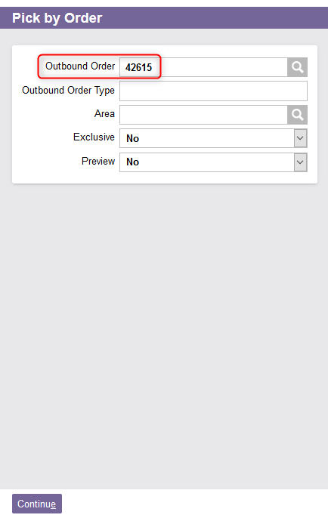
Pick by Order
In the new window, enter the Outbound Order Number.

Slide 44
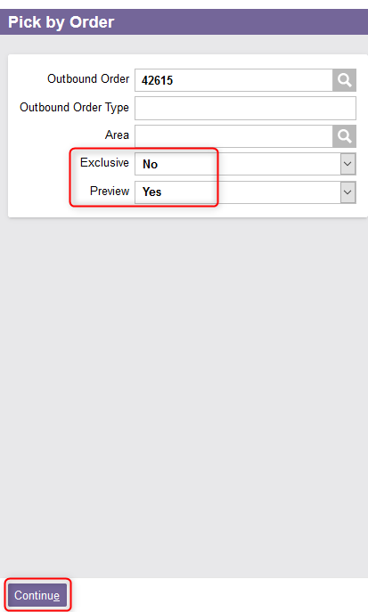
Pick by Order
If desired, set the Exclusive and Preview fields to either Yes or No:
  The Exclusive field allows specifying that no other user will be allowed to pick products for that order. Set to Yes if a user wishes to exclusively pick the order. Select No otherwise.
  By selecting Yes, the Preview field allows searching for a subset of pick commands, instead of automatically accepting and processing the next designated command. The system presents a result set of matching pick commands, allowing the user to select which command to be completed next. Select No otherwise.
Click Continue.

Slide 45
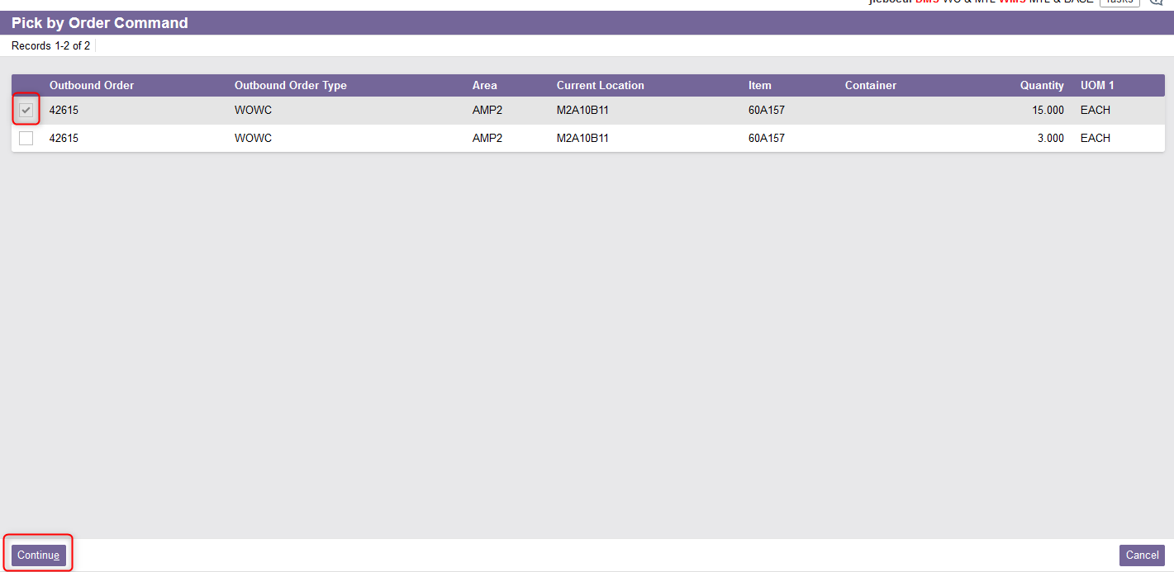
Pick by Order
If you have selected Yes in the Preview field, the Pick by Order Command view is displayed. Select the line that you wish to process.
Click Continue.

Slide 46
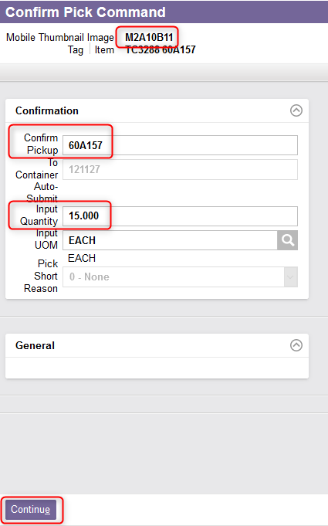

Pick by Order
The Confirm Pick Command view is displayed. Physically take the product from the location specified at the top left of the screen.
Confirm the product picked, as well as the quantity.

Slide 47
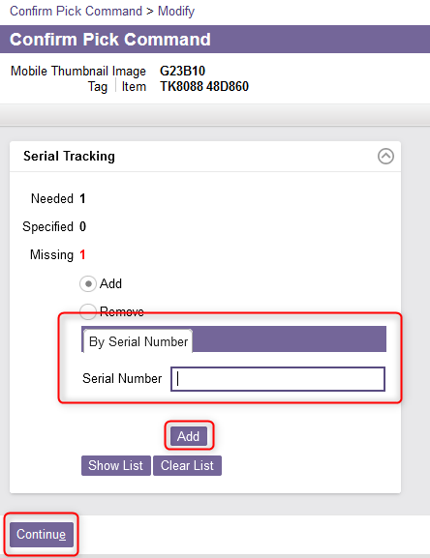
Pick by Order
In the case of an item with a serial number, in the Serial Tracking section, enter the serial number and click Add.
Note: The Show List button will show you the list of available serial numbers. Use the Clear List button to clear the serial numbers you have previously entered.
Click Continue.

Slide 48
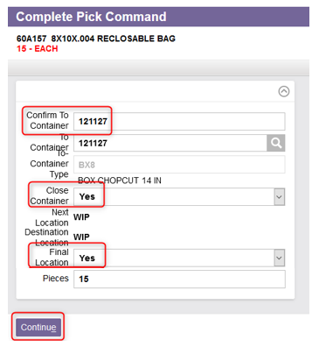
Pick by Order
The Complete Pick Command view is displayed. If the product is being picked into a container, physically move the product to the To Container.
Confirm the To Container.
Optionally, change the Close Container to Yes or No to close or not the Container.
Optionally, change the Final Location field to Yes or No to indicate that the specified location is the final location or not.
Click Continue.

Slide 49
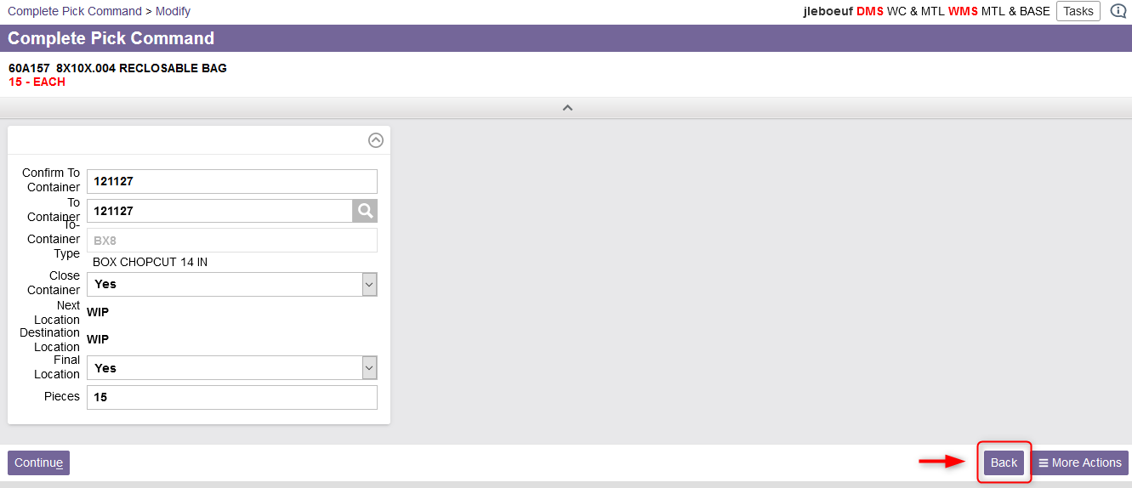
Pick by Order
Additional note - The system goes directly to the next page once the required fields have been completed. At any time, you can return to the previous page by clicking on Back if you wish to review or modify any fields.

Slide 50
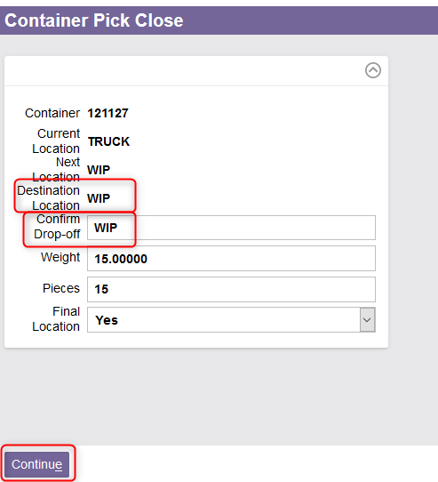
Pick by Order
If the product was picked into a container, the Container Pick Close view is displayed. Physically move the container to the specified Destination Location.
Enter the Drop-off point to confirm the destination location.
Click Continue.

Slide 51
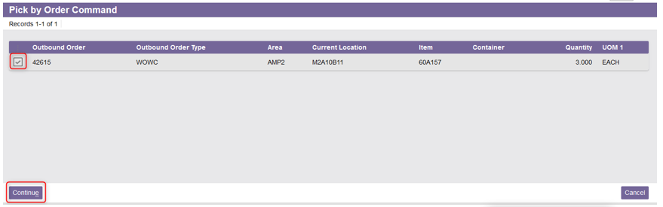
Pick by Order
The system will return to the Pick by Order Command view. You can then choose to process the other lines of the order.
The Confirm Pick Command view will be displayed again. Follow the same steps as explained previously for the rest of the process.

Slide 52
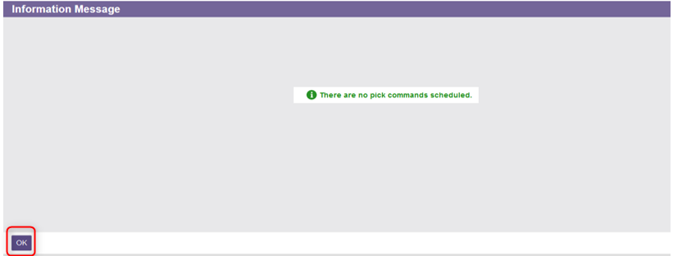
Pick by Order
If there is no more product to pick, the system notifies the user. Click on OK.

Slide 53
Picking with a Mobile Device
Pick by Shipment

Slide 54
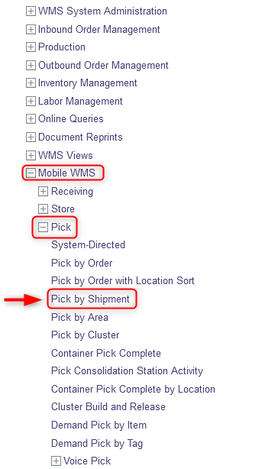
Pick by Shipment
The Pick by Shipment resource allows the user to specify picking a shipment at a time. To do this:
With a mobile device, select the Pick resource.
Under Pick, click on Pick by Shipment.

Slide 55
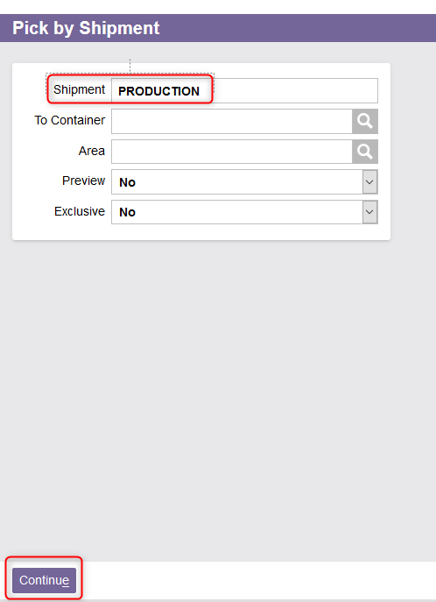
Pick by Shipment
In the new window, enter the Shipment ID.

Slide 56
Pick by Shipment
If desired, set the Exclusive and Preview fields to either Yes or No:
  The Exclusive field allows specifying that no other user will be allowed to pick products for that shipment. Set to Yes if a user wishes to exclusively pick the shipment. Select No otherwise.
  By selecting Yes, the Preview field allows searching for a subset of pick commands, instead of automatically accepting and processing the next designated command. The system presents a result set of matching pick commands, allowing the user to select which command to be completed next. Select No otherwise.
Click Continue.

Slide 57
Pick by Shipment
At this stage, the picking instructions are the same as for Pick by Order.
  If you have selected Yes in the Preview field, the Pick by Shipment Command view will be displayed. Refer to the instructions from the step #6 (slide 45) of the Pick by Order section to perform the following steps.
  If you have selected No in the Preview field, The Confirm Pick Command view will be displayed. Refer to the instructions from the step #8 (slide 46) of the Pick by Order section to perform the following steps.

Slide 58
Picking with a Mobile Device
Cluster Picking

Slide 59
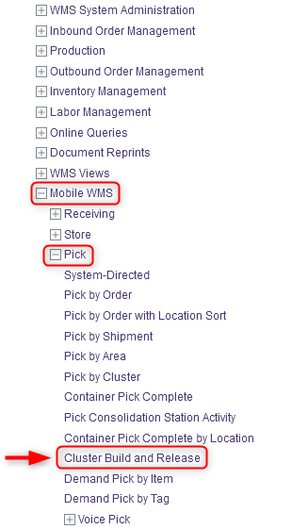
Cluster Picking
Pick by Cluster allows the user to specify a cluster to be picked. You will need to build a picking cluster group and assign labels to the cluster to trigger the picking process. Then, you can perform the picking. To do this:
Based on the Container Type shown on the CPRE label, select the physical containers to pick into and affix the CPRE labels to each of the containers.
With a mobile device, select the Pick resource.
Under Pick, click on Cluster Build and Release.

Slide 60
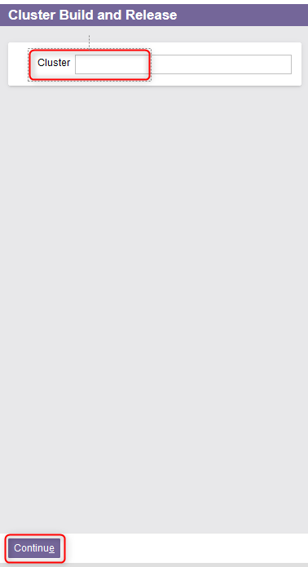
Cluster Picking
Enter a cluster number if desired. To use a system generated Cluster number, leave the Cluster field blank.
Click Continue.

Slide 61
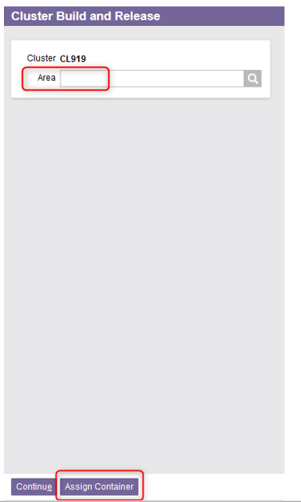
Cluster Picking
From the new window, optionally enter an Area in which the picking will take place.
Select the Assign Container action.

Slide 62
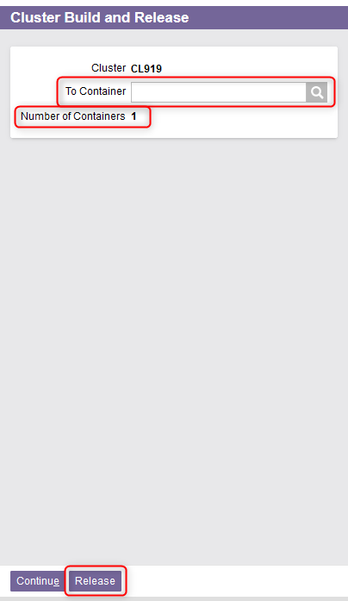
Cluster Picking
Enter the Container ID into the To Container field if you have a container and you want to assign it to the cluster. Use the lookup button if needed.
Keep entering containers as needed. Note: The counter on the screen will display the Number of Containers entered for the cluster.
Once all containers are entered for the cluster, click Release to release the cluster for picking.

Slide 63
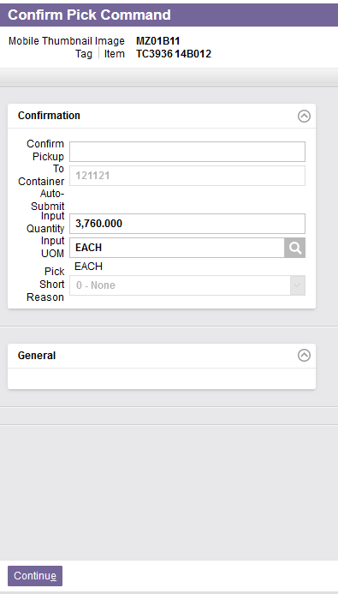

Cluster Picking
The Confirm Pick Command view will be displayed. At this stage, the picking instructions are the same as for Pick by Order. Refer to the instructions from the step #8 (slide 46) of the Pick by Order section to perform the following steps.
Once all the picking commands have been processed, a confirmation message will appear:

Slide 64
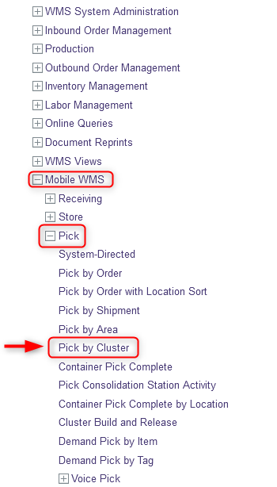
Cluster Picking
Additional note – For any reason, if a cluster already planned and released, has not been completed, you also have the option of selecting the Pick by Cluster resource to process this cluster. To do this:
  With a mobile device, select the Pick resource.
  Under Pick, click on Pick by Cluster.

Slide 65
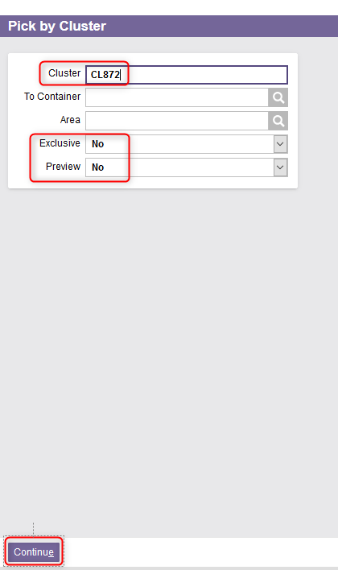
Cluster Picking
In the new window, enter a value in the Cluster field.
As explained previously, set the Exclusive and Preview fields to either Yes or No.
Click Continue.

Slide 66
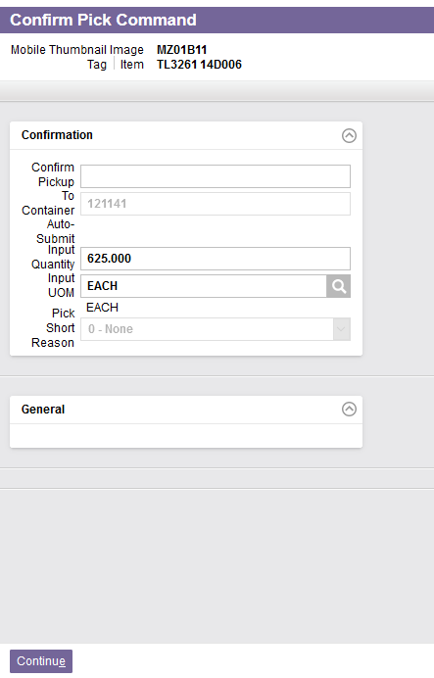

Cluster Picking
The Confirm Pick Command window will be displayed. At this stage, the picking instructions are the same as for Pick by Order. Refer to the instructions from the step #8 (slide 46) of the Pick by Order section to perform the following steps.
Once all the picking commands have been processed, a confirmation message will appear:

Slide 67
Picking with a Mobile Device
Container Pick Complete

Slide 68
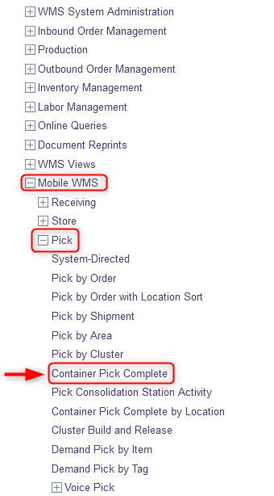
Container Pick Complete
The Container Pick Close view is automatically launched when the system detects that the final pick command has been completed for the container. But it may be necessary to manually close a container outside of the picking workflow. For example, if an operator skipped or closed the Container Pick Close view without confirming the drop-off location. To do this:
With a mobile device, select the Pick resource.
Under Pick, click on Container Pick Complete.

Slide 69

Container Pick Complete
Scan or enter the container that is fully picked.
Click Continue.

Slide 70

Container Pick Complete
Confirm the Drop-off point.
Click Continue.

Slide 71
Picking with a Mobile Device
Exceptions

Slide 72

1- Container Full
If the entire quantity being picked does not physically fit in the current container, you will first need to confirm the picking in the Confirm Pick Command window.
Confirm the pick by scanning or entering the product.
Confirm the amount you could fit into the current container. This could be 0.
Select appropriate Pick Short Reason: “1-Container Full”.
Click Continue.
Complete the pick command in the normal manner, referring to the instructions given previously.

Slide 73

2- Partially Picked
If there is not enough inventory for the item in the location to satisfy the required quantity, you will first need to confirm the picking in the Confirm Pick Command window.
Confirm the pick by scanning or entering the product.
Confirm the actual quantity picked in the Input Quantity field.
Select appropriate Pick Short Reason: “2 - Partially Picked”.
Click Continue. The Complete Pick Command window will appear. Complete the picking as you normally would.

Slide 74

3- Inventory Unavailable
If there is no product in the location to satisfy the required quantity, you will first need to confirm the picking in the Confirm Pick Command view.
It may be necessary to scan or enter the location ID or check digit if there is no physical product available to scan.
Indicate “0" in the Input Quantity field.
Select appropriate Pick Short Reason: “3 - Inventory Unavailable”.
Click Continue.

Slide 75

3- Inventory Unavailable
The system may immediately present you with a Cycle Count for this item in a new window. Refer to the "WMS Tecsys_Cycle Counts" document to complete this step.
Otherwise the picker can skip the cycle count by clicking on the More Actions button, then Skip.

Slide 76

4- Inventory Not Required
If you have been instructed not to pick an item because it is no longer required on the order, you will first need to confirm the picking in the Confirm Pick Command window.
Confirm the pick by scanning or entering the product.
Confirm the amount you have picked in the Input Quantity field. This can be 0.
Select appropriate Pick Short Reason: “4-Inventory Not Required”.
Click Continue. You will be redirected to the main Picking window. Complete the other pick commands if necessary as you normally would.

Slide 77
Picking Exceptions – Summary
During picking, if one of the four situations mentioned previously occurs, the Confirm Pick Command window will allow you to enter the reason for the exception in the Pick Short Reason field.
Below is a summary of the different options available for exceptions during picking:
Note: A cycle count will automatically be generated if the “3 - Inventory Unavailable” option is entered, and the cycle count task will be assigned to the picker who is already in front of the location.
Pick Short Reason | Description
1 - Container Full | The container being picked into has no room. The pick will be completed when another container is brought to the location.
2 - Partially Picked | The quantity of inventory for the product to be picked is insufficient.
3 - Inventory Unavailable | The product to be picked is not available.
4 - Inventory Not Required | For whatever reason, the user indicates that some inventory the system requests is unnecessary for the order.

Slide 78
Conventional Picking

Slide 79
Conventional Picking
When a picking is generated through a desktop computer, a paper-based list will be printed to be used by the user to perform the requested picking.
The Pick List header contains the Bill To/Ship To information, the Pick List Number as well as other relevant information.
For each line item on the pick list, the following information is provided:
  Shipment Order
  From/To Location
  Item Description and UPC
  UoM and Package Code
  From/To Container
  Quantity to be picked

Slide 80

Conventional Picking

Slide 81

Conventional Picking
To perform a conventional picking from a paper-based list:
Take the Pick list.
Go to the From Location specified on the list.
Take the product in the Requested Quantity specified.
Place the product in the To Container.
As you take product, mark the Picked Quantity on the list.
Then take the product to the To Location.

Slide 82

Conventional Picking
Once the user has picked all products specified by the paper-based list, the Pick List Completion resource is used to enter any pick quantity discrepancies. To do this:
With a desktop computer, select the Outbound Order Management resource.
Under Outbound Order Management, click on Picking.
Under Picking, click on Pick List Completion.

Slide 83

Conventional Picking
The Pick List Preparation window is displayed. Enter the pick list number, which is in the upper-right-hand corner of the paper list.
Click Submit.

Slide 84

Conventional Picking
The record is retrieved into the Pick List Completion view’s Search page. For each line item:
  Confirm the quantity picked in the Input Quantity field.
  Change the To Container if needed.

Slide 85

Conventional Picking
If a Pick Short Reason must be entered for an item, select the View Record Details action.

Slide 86

Conventional Picking
Change the fields as needed and select the appropriate Pick Short Reason. Refer to the slide #76 for more details on the Pick Short Reasons.
Click Submit.

Slide 87

Conventional Picking
Once the pick list is ready to be completed, select the Complete Pick List action

Slide 88

Conventional Picking
A new window will appear. Click Submit to confirm.

